Slide 1
Chapter 5
Common Functions and their Properties
The concept of functions is a very basic part of mathematics and one that appears in all forms of algebra, trigonometry, and calculus. While there are hundreds of different types of mathematical functions, certain common ones tend to occur quite often in applied engineering and scientific applications. In this chapter, we will explore some of these most common functions and study their behavior.

Slide 2
Now that basic MATLAB matrix operations and curve plotting have been covered, much of the work that follows will provide coverage of the MATLAB commands immediately after introducing the mathematical forms. This will be the norm where the commands are fairly simple and are best introduced after discussing the mathematical form. In particular, the need to plot curves of functions immediately after introducing the functions will be best achieved with MATLAB commands.

Slide 3
Functions
A function is a relationship between two or more variables. At this point in the text, we will consider only the variables x and y for a given function. In most cases, we will consider that x is the independent variable and y is the dependent variable. This does not necessarily mean that x causes y in all cases, but it suggests that we first assign a value of x and then determine the value or values of y.

Slide 4
Horizontal and Vertical Axes
Normally, x is assigned to the horizontal axis and y is assigned to the vertical axis. The general notation indicating that y is a function of x will take the form y=f(x) and letters other than f may be used when there are several functions. Alternately, subscripts may be added to different functions to give them separate identities. Sometimes, we will use the simpler notation y=y(x) to mean the same thing.

Slide 5
Single-Valued versus Multi-Valued
A single-valued function is one in which a single value of x results in a single value of y. A multi-valued function is one in which a single value of x results in more than one value of y. An example of a single-valued function is shown in Figure 5-1(a), and a multi-valued function is shown in Figure 5-1(b). Both appear on the next slide.

Slide 6
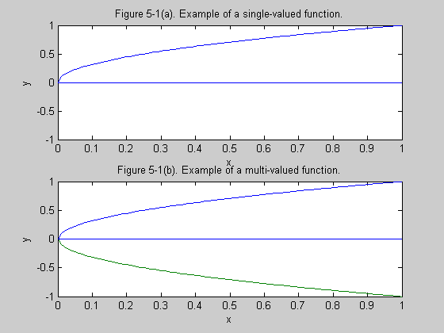

Slide 7
Continuous versus Discontinuous
The definition of a continuous function is one in which at any value of the independent variable, approaching the value from the left results in the same dependent value as approaching the value from the right. An example of a continuous function is shown in Figure 5-2(a), and a function that has one finite discontinuity is shown in Figure 5-2(b). Both appear on the next slide.

Slide 8
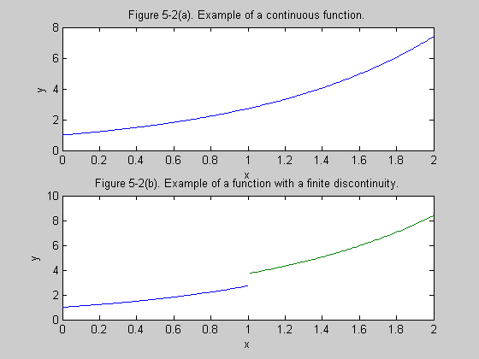

Slide 9
Domain and Range
Assume that a function is being evaluated over specific limits such as from x₁ to x₂. This portion of the x-axis is called the domain. All values of the dependent variable y that are produced in the process are called the range. In casual usage, engineers and technologists tend to refer to both as ranges.

Slide 10
Inverse Functions
If we have a function y=f(x), and we can reverse the process and solve for x in terms of y, we have the inverse function. For the moment, we will denote the inverse simply as x=g(y). We will retain the original variable names and then consider y as the independent variable and x as the dependent variable.

Slide 11
Even and Odd Functions
An even function is one that satisfies
f(-x)=f(x)
Figures 5-4 and 5-6 are even functions.
An odd function is one that satisfies
f(-x)=-f(x)
Figures 5-5 and 5-7 are odd functions.

Slide 12
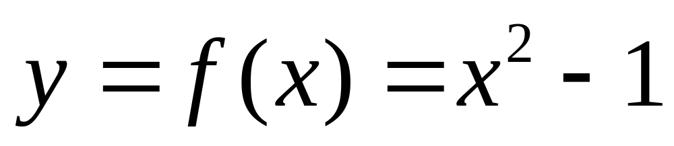
Example 5-1. Determine if the function below is single-valued or multi-valued.
With x as the independent variable and y as the dependent variable, there is only one value of y for a given value of x. Hence the function is single-valued.

Slide 13
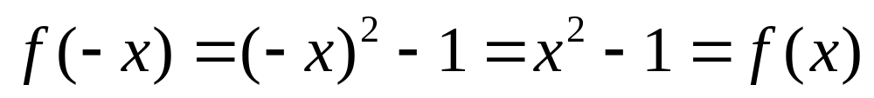
Example 5-2. Is the function of Example 5-1 even, odd, or neither.
Since f(-x)=f(x), the function is even.

Slide 14
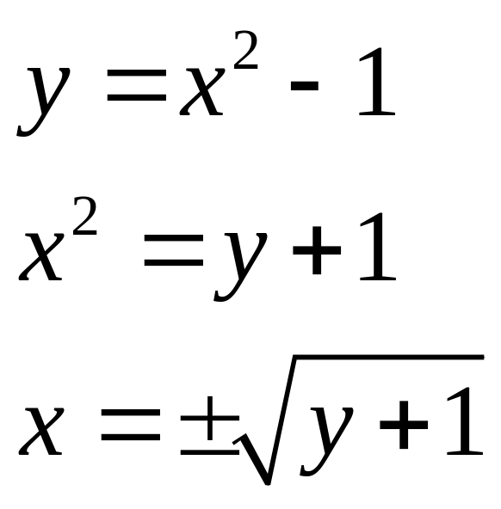
Example 5-3. Determine the inverse of the function of Example 5-1.
We now consider y as the independent variable and x as the dependent variable.

Slide 15
Example 5-4. Is the inverse function of Example 5-3 single-valued or multi-valued?
Since two values of x result from a given value of y, the inverse function is multi-valued. This tells us that a function may be single-valued but its inverse may be multi-valued or vice-versa. In many applications, only the positive square root would be of interest, so if the negative square root is rejected, we could interpret the result as being single-valued.

Slide 16
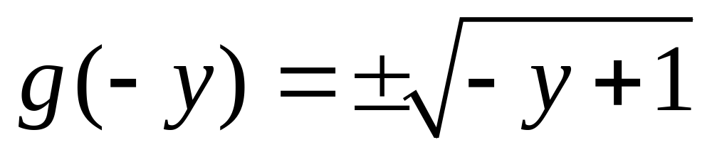
Example 5-5. Is the inverse function of Example 5-3 even, odd, or neither?
The inverse function is neither even nor odd.

Slide 17
MATLAB Subplot
The subplot allows more than one plot to be prepared on the same printer page. In fact, Figures 5-1 and 5-2 were both prepared using that command.The syntax for the subplot command is as follows:
>> subplot(m, n, k)
Integers m and n define the number of rows and columns of subplots. The integer k defines the particular one based on left to right and top to bottom.

Slide 18
Example 5-6. Plot the function of Example 5-1 and the inverse of Example 5-3 using subplots.
>> x = linspace(-2, 2, 201);
>> y = x.^2-1;
>> subplot(2, 1, 1)
>> plot(x, y)
Additional labeling commands were used.
>> subplot(2, 1, 2)
>>plot(y, x)
Additional labeling commands were used.

Slide 19
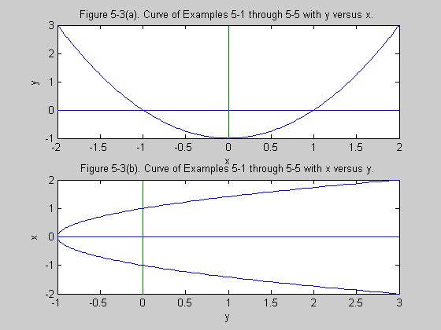

Slide 20
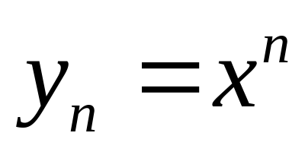
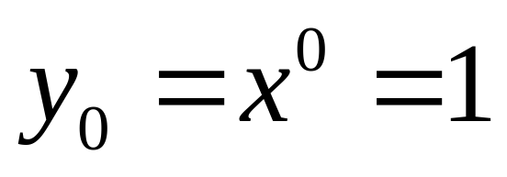
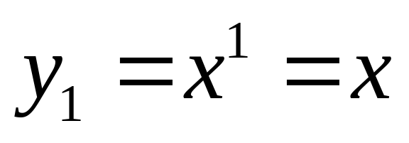
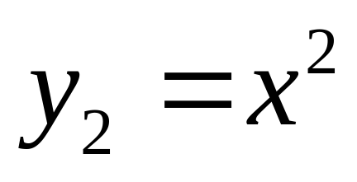
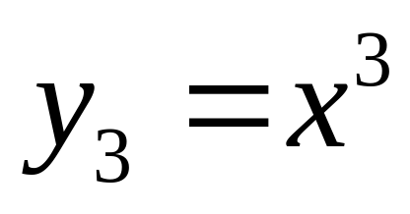
Power and Polynomial Functions

Slide 21
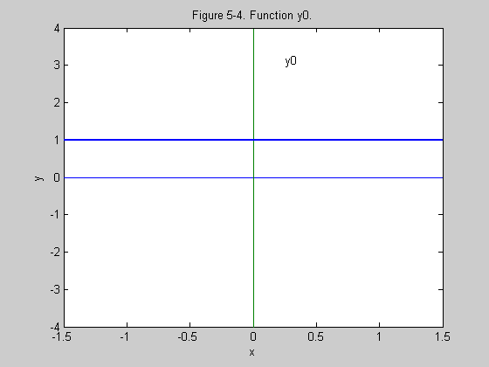

Slide 22
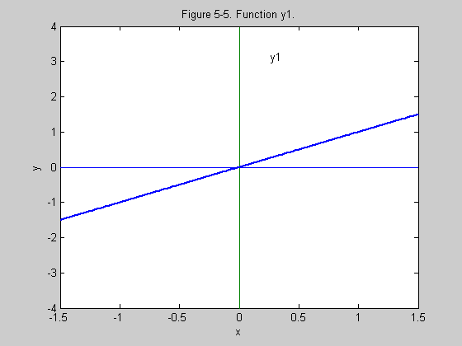

Slide 23
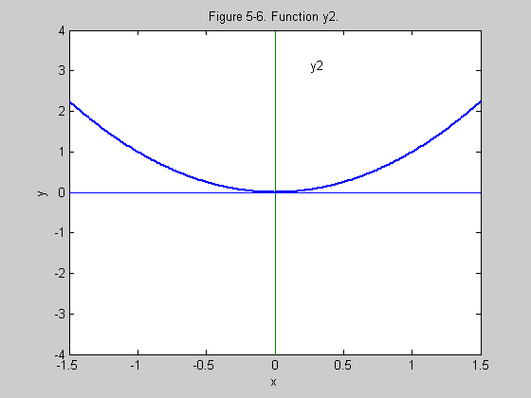

Slide 24
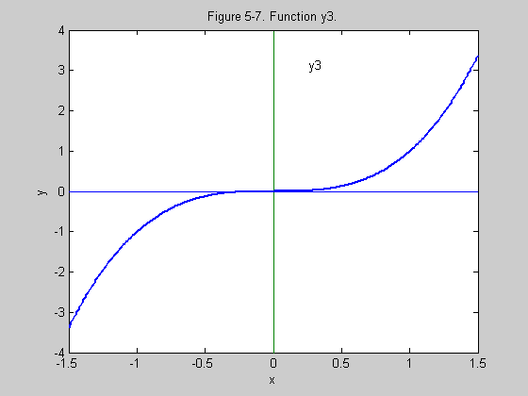

Slide 25
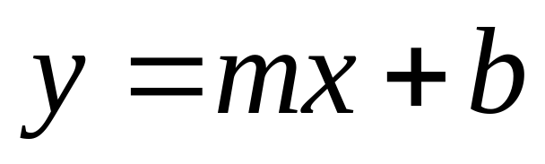
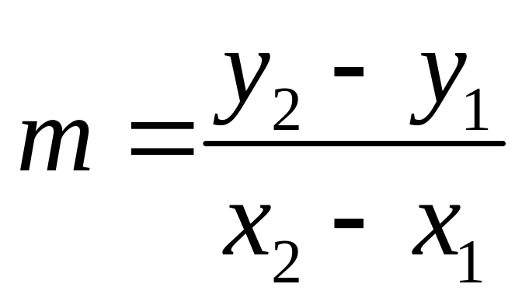
Straight-Line Equation
The quantity m is the slope of the line and b is the vertical intercept. For m>0, the slope is upward and for m<0, the slope is downward. The line crosses the vertical axis at a value b.

Slide 26
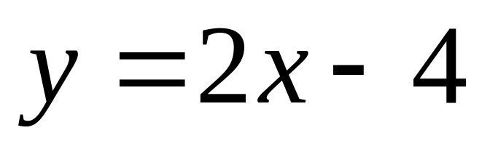
Example 5-7. Write the equation and plot the line having a slope of 2 and a vertical intercept of -4.
This case is about as simple as any can be since we are given the two parameters required in the slope/vertical intercept form. The straight-line is shown on the next slide.

Slide 27
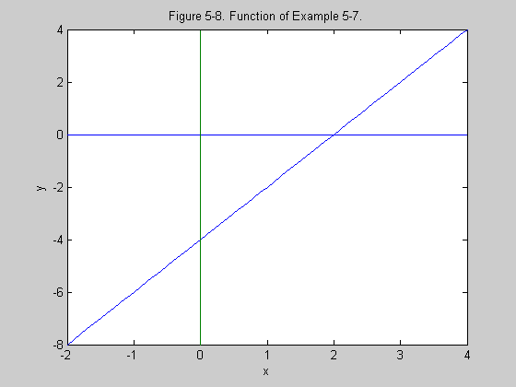

Slide 28
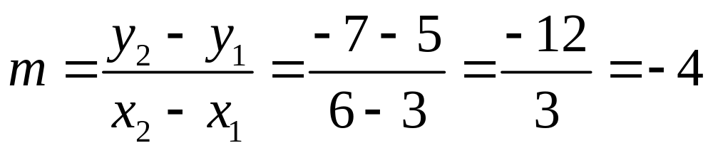
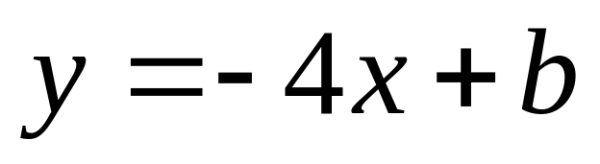
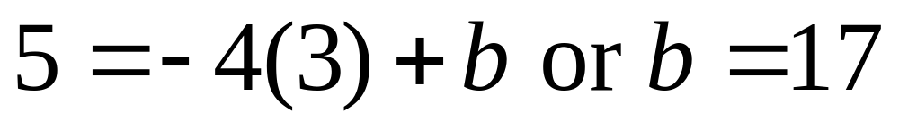
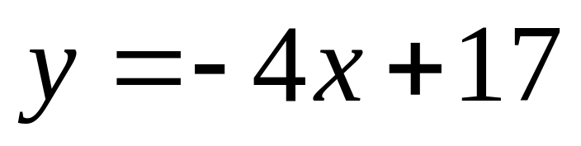
Example 5-8. Write the equation and plot the line passing through the points (3, 5) and (6, -7).

Slide 29
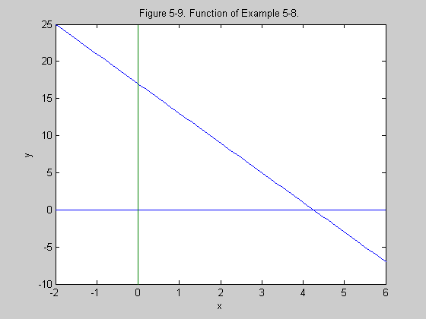

Slide 30
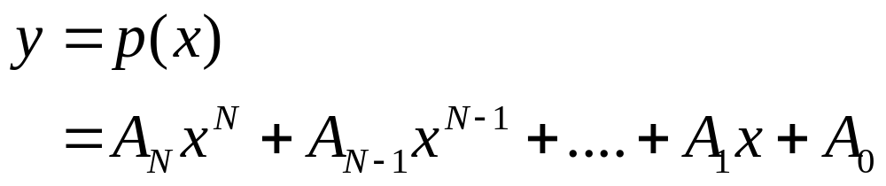
Polynomial Functions
A polynomial function is one composed of a sum of power terms of the form of x^{n} with integer values of n and constant factors. A typical polynomial function of degree N can be expressed in the following form:

Slide 31
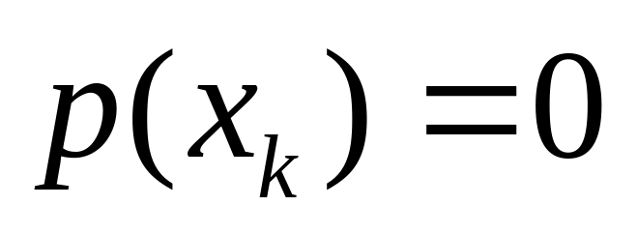
Roots of a Polynomial Function
A root of a polynomial equation is a value of x such that the polynomial is zero when it is evaluated for that particular value of x. This means that for any root x_{k} of the polynomial p(x) on the previous slide, the following equation is satisfied:

Slide 32
Theorem on Roots
A polynomial of degree N has exactly N roots. These roots may be classified as
1. Real roots of first order
2. Complex roots of first order
3. Real roots of multiple order
4. Complex roots of multiple order
In this classification scheme, purely imaginary roots may be considered as a special case of complex roots.

Slide 33
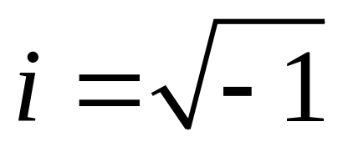
Complex Roots
For real polynomial coefficients, any complex roots appear in conjugate pairs. Thus, if a+ib is a root, a-ib will also be a root. The value a-ib is the complex conjugate of a+ib. The quantity i is the basis for the complex number system and is given by

Slide 34
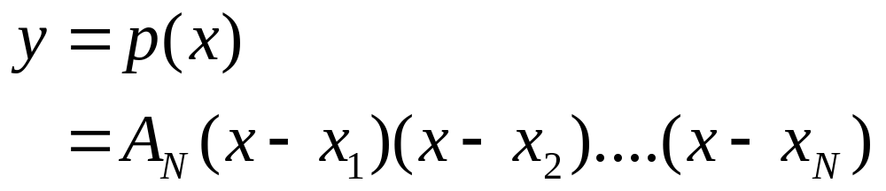
Factored Form of a Polynomial

Slide 35
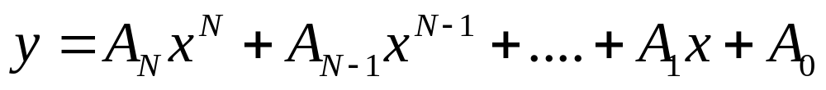
MATLAB Evaluation of Polynomial
Assume that the vector x has been entered. To illustrate for the third degree case, one way to evaluate is shown below.
>> y = A3*x.^3 + A2*x.^2 + A1*x + A0
An easier way will be shown on the next slide.

Slide 36
Easier MATLAB Procedure for Polynomial Evaluation
Define a row vector C as follows:
>> C = [A3 A2 A1 A0];
The polynomial will be evaluated at all values of x by the command
>> y = polyval(C, x)

Slide 37
Factoring of Polynomials
Define a row vector C as follows:
>> C = [A3 A2 A1 A0];
The roots will be determined by the command
>> R =roots(C)
The vector R as is a column vector whose values are the roots of the polynomial.

Slide 38
Forming the Polynomial from the Roots
Assume that the roots of a polynomial are formed as either a row or a column vector and denoted as R. The coefficient matrix C of the polynomial is determined by
>> C = poly(R)
If the coefficient of the highest degree term is other than one, it is necessary to modify C as follows:
>> C = AN*C

Slide 39
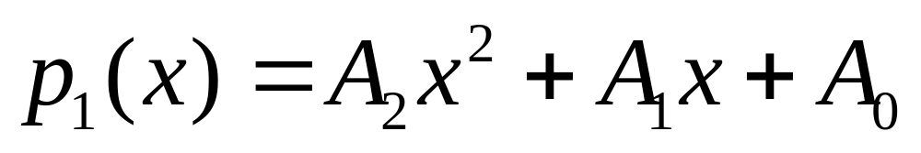
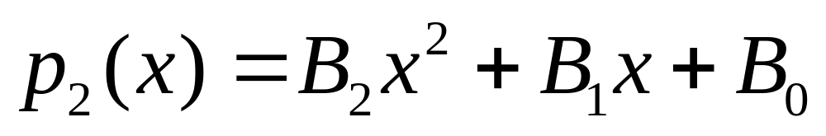
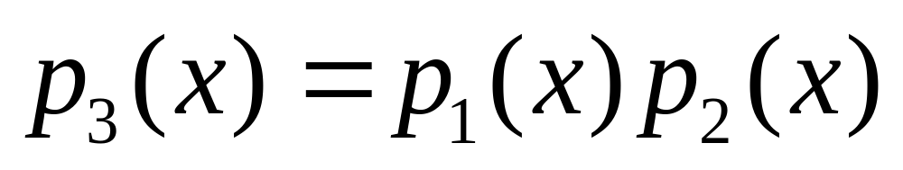
Multiplication of Polynomials
Two polynomials can be multiplied together by the use of the conv command. The term conv is a contraction of the term convolution which has applications in signal processing and in both differential and difference equations. To illustrate, assume two 2nd degree polynomials.

Slide 40
Multiplication of Polynomials Continuation
Form row vectors for the coefficients.
>> C1 = [A2 A1 A0];
>> C2 = [B2 B1 B0];
The coefficient matrix of the product polynomial is obtained by the command that follows.
C3 = conv(C1, C2)

Slide 41
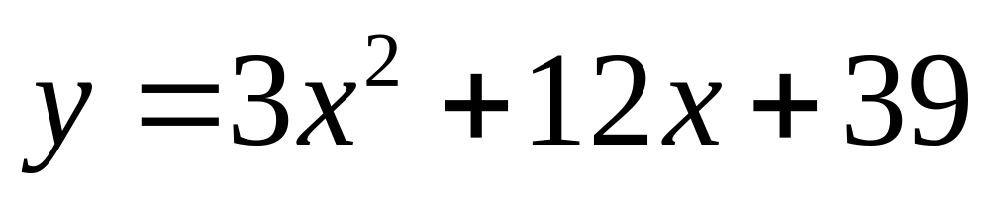
Example 5-9. Use MATLAB to determine the roots of
>> C = [3 12 39];
>> R = roots(C)
R =
-2.0000 + 3.0000i
-2.0000 - 3.0000i

Slide 42
Example 5-10. Reconstruct the coefficients of the polynomial from the roots of the preceding example.
>> C1 = 3*poly(R)
C1 =
3 12 39
We could use the polyval command to evaluate the polynomial if desired.

Slide 43
Example 5-11. Determine the roots of the 5th degree polynomial below.
>> C=[1 3.2361 5.2361 5.2361 3.2361 1];
>> R = roots(C)
R =
-0.3090 + 0.9511i
-0.3090 - 0.9511i
-1.0000
-0.8090 + 0.5877i
-0.8090 - 0.5877i

Slide 44
Example 5-12. Reconstruct the polynomial of Example 5-11 from the roots.
Assume that the 5 roots are still in memory as a vector.
>> C1 = poly(R)
C1 =
1.0000 3.2361 5.2361 5.2361 3.2361 1.0000

Slide 45
Example 5-13. Evaluate the 5th degree polynomial for x = 0, 0.5, 1, and 2.
Assume that C is still in memory.
>> x = [0 0.5 1 2];
>> y = polyval(C, x)
y =
1.0000 4.8151 18.9444 154.0830

Slide 46
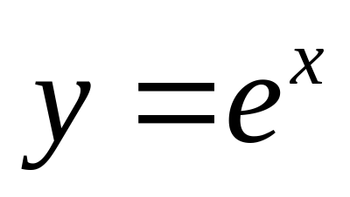
Exponential Function to the Base e
The basic exponential function arises in a large number of scientific and engineering problems. The "purest" form of the exponential is as a power of the mathematical constant e=2.718 to four significant digits. The form of the function for both positive and negative x is shown on the next slide.

Slide 47
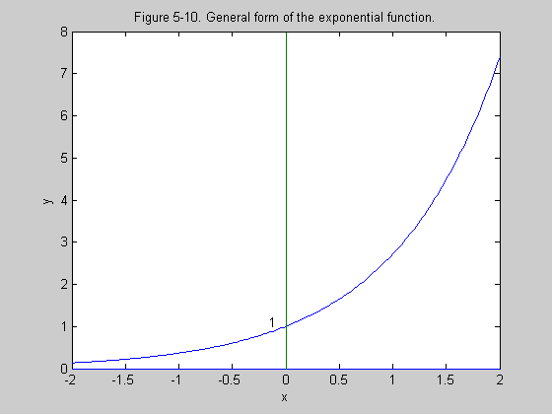

Slide 48
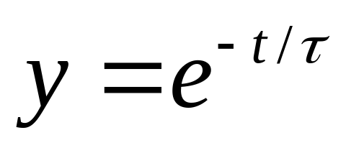
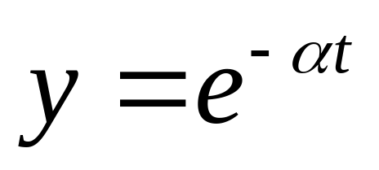
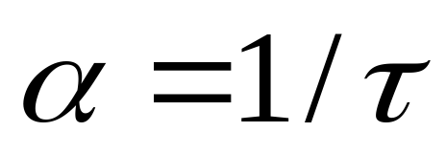
Decaying Exponential Function
The most common form of the exponential function in practical engineering problems is the decaying or damped exponential function. Many applications involve time as the independent variable and the forms are shown below and on the next slide.

Slide 49
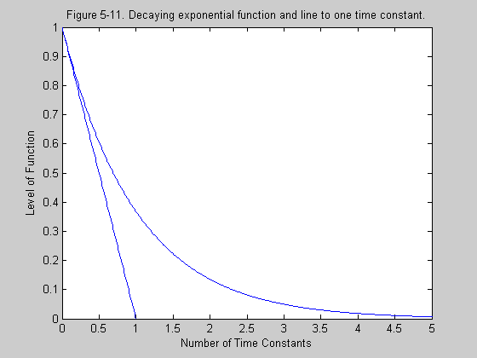

Slide 50
MATLAB Exponential Forms
Assume that a vector x is in memory. MATLAB uses exp for e and the command to generate y is
>> y = exp(x)
If a base other than e is desired, the exponentiation operation is used. For example, if the base is 10, the command is
>> y = 10.^x

Slide 51
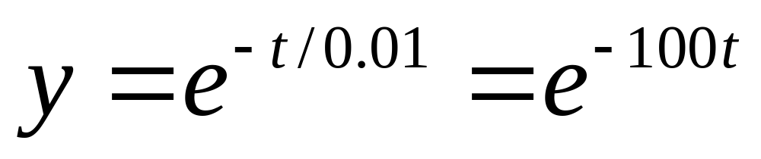
Example 5-14. Consider the exponential function shown below.
Determine (a) the time constant and (b) the damping constant. (c). Based on the rule-of-thumb provided in the text, about how long would it take to reach a practical level of zero?

Slide 52
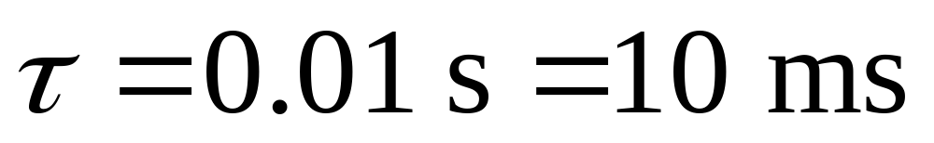
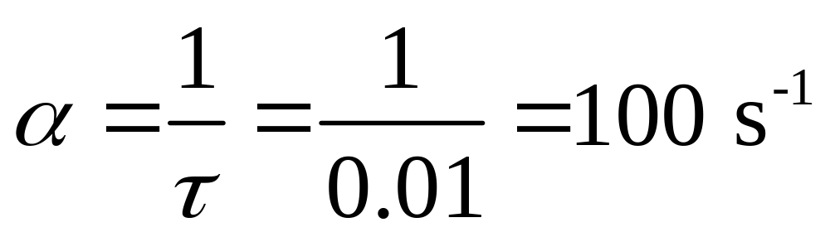
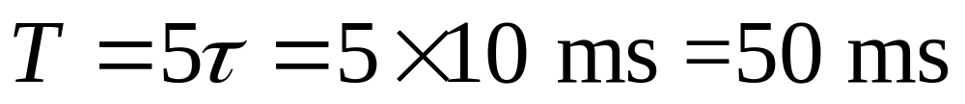
Example 5-14. Continuation.

Slide 53
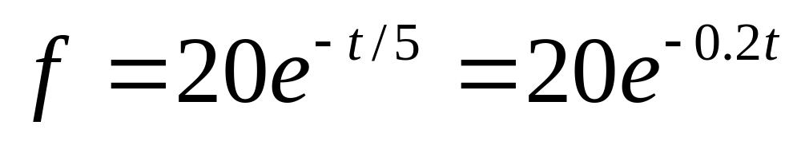
Example 5-15. A force f begins with 20 N and decays exponentially with a time constant of 5 s. Write the equation.

Slide 54
Example 5-16. Generate the two curves of Figure 5-11 and plot them.
One is the exponential function and the other is the straight-line y1 = 1 - x.
>> x = linspace(0, 5, 501);
>> y = exp(-x);
>> x1 = linspace(0, 1, 11);
>> y1 = 1-x1;
>> plot(x, y, x1, y1)
Other routine labeling was provided on Figure 5-11.

Slide 55
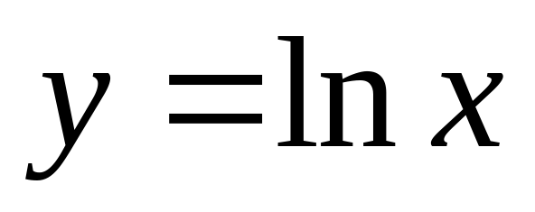
Logarithmic Function
The logarithmic function is the inverse of the exponential function. However, because it arises in many applications, it will be represented in the usual form with x as the independent variable and y as the dependent variable. The mathematical form is provided below and a curve is shown on the next slide.

Slide 56
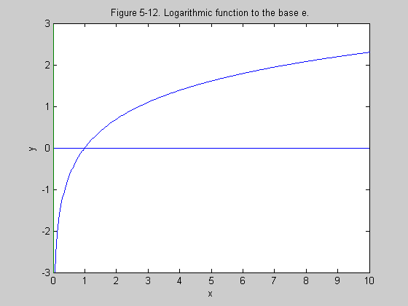

Slide 57
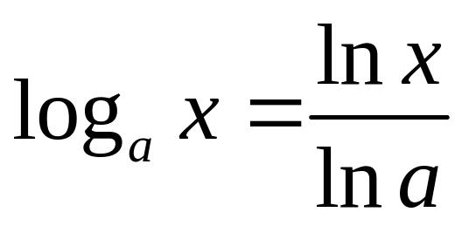
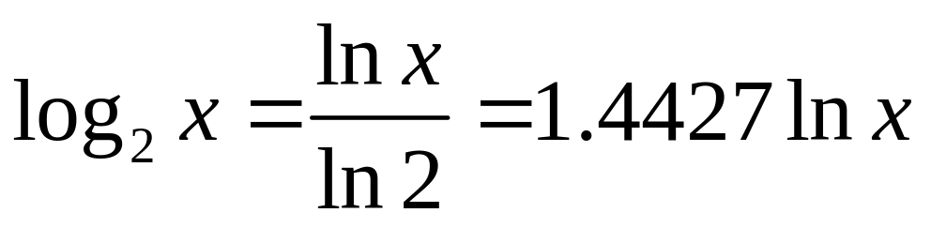
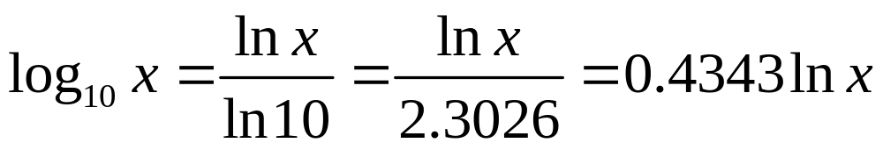
Logarithms to Other Bases
In general, the logarithm to a base a other than e is determined by the first equation below. The base 2 and the base 10 are also considered.

Slide 58
MATLAB Logarithmic Commands
The logarithm to the base e in MATLAB is
>> y = log(x)
This could be confusing since some math books use log(x) to mean to the base 10.
The logarithm to the base 10 in MATLAB is
>> y = log10(x)

Slide 59


Example 5-17. Some definitions are provided below.
Use MATLAB to develop a conversion curve in which G varies from 0.01 to 100. Use a semi-log plot with G on the horizontal logarithmic scale and G_{dB} on the vertical linear scale.

Slide 60
Example 5-17. Continuation.
The command to generate G on a logarithmic scale from 0.01 to 100 is
>> G = logspace(-2, 2, 200);
The decibel gain is generated by
>> GdB = 10*log10(G);
A logarithmic x scale and a linear y scale are generated by the command
>> semilogx(G, GdB)
A grid and additional labeling are provided and the curve is shown on the next slide.

Slide 61


Slide 62
Example 5-18. Plot the absolute gain versus the decibel gain from Example 5-17.
We could solve for G in terms of GdB, but that is unnecessary since we have both G and GdB in memory. We simply reverse the order of the variables and change semilogx to semilogy. The command is
>> semilogy(GdB, G)
The plot with additional labeling is shown on the next slide.

Slide 63


Slide 64

Example 5-19. Use MATLAB to plot the gaussian function shown below over the domain from -3 to 3.
>> a = 1/(sqrt(2*pi));
>> x = linspace(-3,3,301);
>> y = a*exp(-0.5*x.^2);
>> plot(x, y)
With additional labeling, the curve is shown on the next slide.

Slide 65


Slide 66
Trigonometric Functions
There are six basic trigonometric functions: (1) sine, (2) cosine, (3) tangent, (4) cotangent, (5) secant, and (6) cosecant. However, the first three tend to occur more often in practical applications than the latter three. Moreover, the latter three can be expressed as reciprocals of the first three (not in the order listed). Therefore, we will focus on the first three, but the definitions of the latter three will be provided for reference purposes.

Slide 67


Angle Measurement
The most basic mathematical unit for an angle is the radian (rad). It does have a mathematical basis for its form and does arise as a natural process. One complete revolution for a circle corresponds to 2π radians. To convert between radians and degrees, the following formulas can be used:

Slide 68

Figure 5-16. Right-triangle used to define trigonometric functions.

Slide 69






Trigonometric Definitions

Slide 70
Sine Function
The form of the sine function over the domain from 0 to 2π is shown on the next slide.The function is periodic, meaning that it repeats the pattern shown for both positive and negative x. The domain shown constitutes one cycle of the periodic function and the period on an angular basis is 2π radians.
The sine function is an odd function.

Slide 71


Slide 72
Cosine Function
The form of the cosine function over the domain from 0 to 2π is shown on the next slide. As in the case of the sine function, the cosine function is periodic with a period of 2π radians on an angular basis.
The cosine function is an even function.

Slide 73


Slide 74
Tangent Function
The form of the tangent function over the domain from 0 to 2π is shown on the next slide.This function is periodic, but there are two cycles shown in the given domain. Hence, the tangent function is periodic with a period of π radians on an angular basis.
The tangent function is an odd function. Moreover, it has infinite discontinuities at odd integer multiples of π/2.

Slide 75


Slide 76
MATLAB Trigonometric Functions
The 6 MATLAB commands are
>> y = sin(x)
>> y = cos(x)
>> y = tan(x)
>> y = cot(x)
>> y = sec(x)
>> y = csc(x)

Slide 77



Sinusoidal Time Functions

Slide 78


Period and Frequency
For either the sine or cosine, the quantity ω is the number of radians per second that the function undergoes in the argument. This quantity is called the angular velocity in mechanics and is called the angular frequency in electricity. It is related to the cyclic frequency by the relationship

Slide 79


Combining Sine and Cosine Functions at the Same Frequency
The sum of a sine and a cosine function at the same frequency may be expressed as either a sine or a cosine function with an angle. The angle may be determined from the phase diagram on the next slide.

Slide 80


Slide 81


Example 5-20. Use MATLAB to plot the function below over two cycles.
>> x = linspace(0, 2, 201);
>> y = 20*sin(2*pi*x+pi/6);
>> plot(x, y)
The plot is shown on the next slide.

Slide 82


